Slide 1

A COMPUTER ASSISTANT ACCESSIBLE THROUGH VOICE
This project & presentation is for partial fulfilment of
Problem Solving Using Python Programming
(CS22001)
Session: 2022-23
By:
G-10, Team - 03
Lalit Kumar Yadav 2210991848
Latika Bansal 2210991849
Lavanya Kapoor 2210991850
Supervisor:
Dr. Sanjoy Kumar Debnath
Institute of Engineering & Technology
Department of Computer Science and Engineering
Chitkara University, Punjab, India
Date: December 13th 2022

Slide 2
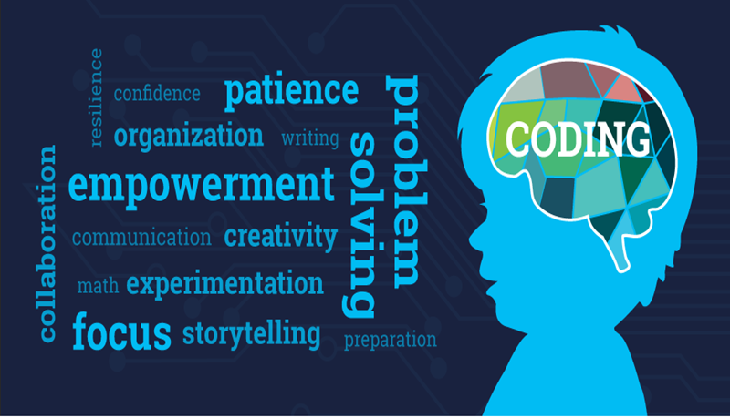
OUTLINE:
Introduction/Background
Problem Statement
Aim and Objectives
Methodology
Result and Analysis
Limitations of the project
Conclusions
Recommendations
Reference
Appendix

Slide 3
Introduction:
The computer assistant created works like a simple command button which accepts input from the user in the form of voice, coordinates with the modules and statements used and gives the desired output, simple commands ranging from “open google”, “play a song”, “tell me a joke” to “what is the date”, “what is the time?", "what is the weather in America etc?”, our assistant named MAXY does all of it for the user just at one click. The medium in which the output is delivers may be in the form of text, audio or just by opening the application which the user wants.

Slide 4

problem statement:
1. Local Platform:-
Different computers around the world use different Operating system. Ranging from windows to mac iOS, each software on its home screen has a search button to search the various applications. No doubt that applications like google assistant, Alexa and Siri perform a similar function, but they perform it only on their particular platforms while our software ,MAXY, works in every intelligent system. However, only some softwares include the option to search and find the application feature.
This is the part where our program comes to rescue

Slide 5

2. Novelty:-
With the addition of this feature, with some more improvements, the performance of the software around the word can be enhanced for the better while decreasing the load of typing.
This will increase the efficiency and even help user to get rid of the task to type and search for the application.
3. Removal of Type Error:-
Furthermore, since type error sometimes leads to misnavigation and the user is unable to find the application, this feature od speaking will directly open the application or execute the command even if the user misspells the name.

Slide 6
aim and objectives:
Objectives | Underlying Target
1. The command prompt takes input from the user in the form of voice. | 1. To take input from the user.
2. The program then traces back to the module used to give the output. | 2. To trace back to the module and statement in the program.
3. The output is given in the form of text, voice or by executing the command as requested by the user. | 3. To give the output as per the command.

Slide 7


Slide 8

Methodology:
Input command in audio form.
If the command is “Stop”, than end.
If the task in the command is present in the software, than run the command.
If the task is not present in the software, than the software will show Try again or Check connection or I don’t understand.
False

Slide 9

Implementation:
Microphone Specification:
Use your voice for apps using Microsoft's
online speech recognition technology.
Your everyday use of apps that use online speech
recognition could improve the accuracy of
online speech technology for everyone who speaks your language.
2. Device Information:
Device name – realmelaptop
Processor – 11th Gen Intel(R) Core(TM) i3-1115G4 @ 3.00Hz 3.00GHz
Installed RAM – 8.00 GB (7.79 GB usable)
System Type- 64-bit operating system, x64-based processor
Pen and touch- No pen or touch is available for this display

Slide 10
RESULT AND ANALYSIS:
Our computer assistant named MAXY is an amalgamation of audio and text interface. As shown in Fig1. the name of the modules used make their functions clear. The methodology exemplifies how the commands are executed and the result is displayed. With one illustration, it is easy to analyze the efficiency and the aid that this program provides to the use. For the most valued possession in the world that is “less work, less pressure”, our program makes sure that used don’t even need to use their hands for a game changing experience which still doesn’t exist in most of the operating systems around the world.

Slide 11
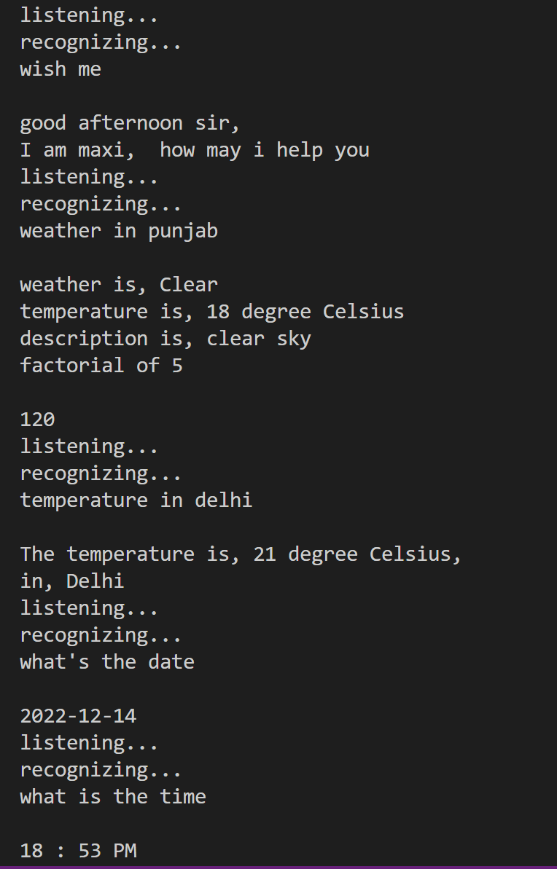
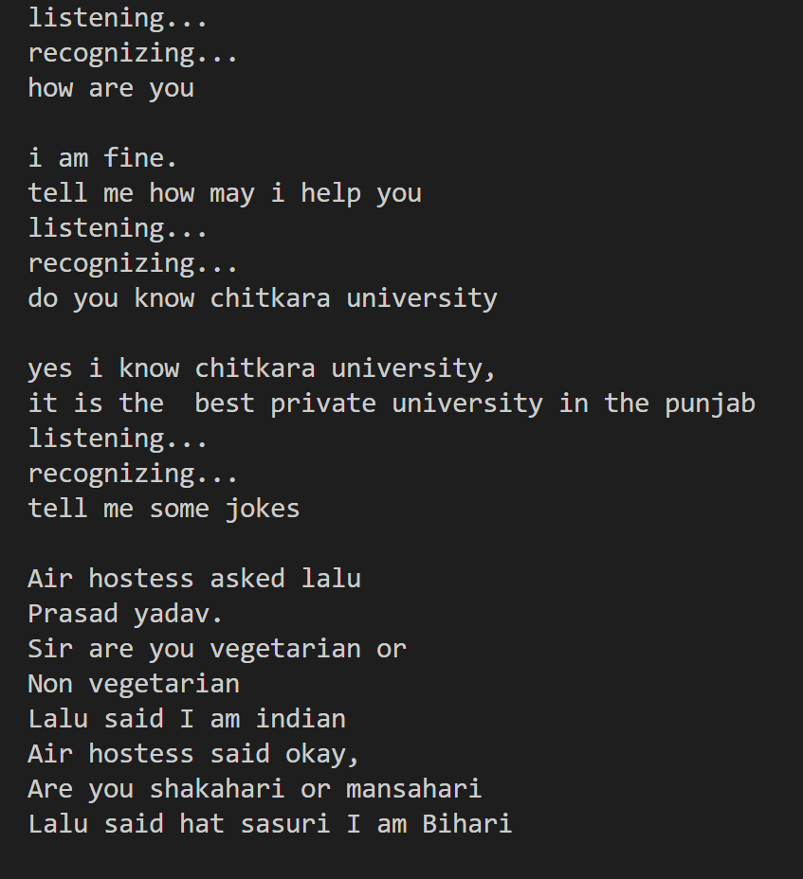
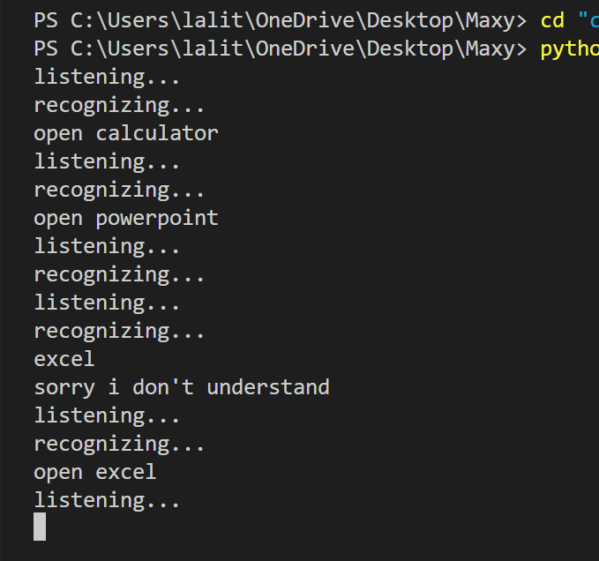
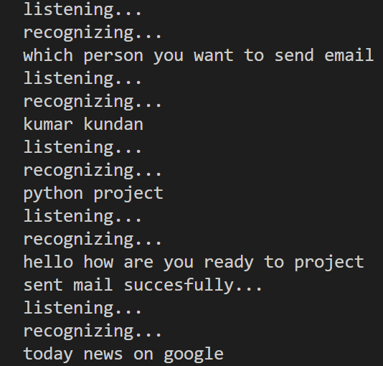

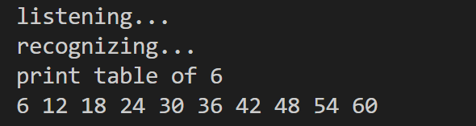
Fig2.
Fig3.
Fig4.

Slide 12
LIMITATIONS OF THE PROJECT:
1. Lack of graphics:
The program created by our group is at a budding stage and is just a prototype of the vision that we wish to execute. The program is still in need of some constructive and pragmatic additions, since our assistant is developed on python, it is just being used without any graphics. Hence, development of graphics is our important concern and a limitation since at the present moment it is out of out might.
2. Finishing touches:
Furthermore, though is it true that we tried adding most of the common command we could think of, the program still requires finishing touches to emerge as the visionary assistant that we want

Slide 13

CONCLUSIONS:
Our assistant MAXY is a computer assistant developed on python. As explained above it has its advantages, limitations as well as further scope. We rest our case by saying that Overcoming the limitations and push it to emerge as a perfect assistant is our primary aim. We created this program with a basic aim of being able to contribute to the IT industry with just even a small program. It showcases in an easy, interactive and efficient way that how the modules of the python and simple if else statement can help us make an assistant with a novel approach. Our computer assistant which works on audio commands and helps you open the application you desire to open.

Slide 14

RECOMMENDATIONS:
Presently this feature does not exist in any operating systems like windows and macOS. We created this assistant by applying simple modules and if-elif-else conditions with a basic aim of being able to contribute to the IT industry with just even a small program. If this feature could be incorporated in the windows or the mac than the functioning can be revolutionised.

Slide 15

REFERENCE:
1. YouTube
https://youtu.be/buoSzgX9yM4
https://www.youtube.com/live/sHeJgKBaiAI?feature=share https://youtu.be/BsVQ_cBmEwg https://youtu.be/BsVQ_cBmEwg
2. Google
pypi.org website--> https://pypi.org/project/pycopy-webbrowser/ https://pypi.org/project/secure-smtplib/ https://pypi.org/project/openpyxl/
3. Books
Let us Python

Slide 16
# set voice rate
rate = engine.getProperty('rate')
engine.setProperty('rate', 178)
# create current datetime
cur_time = datetime.datetime.now().strftime('%H:%M:%S')
# take only hour
hour = int(datetime.datetime.now().hour)
minut = int(datetime.datetime.now().minute)
# whether
def speak(text):
engine.say(text)
engine.runAndWait()
def wishme(text):
print(text)
print()
if hour >= 0 and hour <= 12:
print('good morning sir,\n I am maxi, \n how may i help you')
speak('good morning sir, I am maxi, \n how may i help you')
elif hour >= 12 and hour <= 18:
print('good afternoon sir, \nI am maxi, how may i help you')
speak('good afternoon sir, I am maxi, how may i help you')
else:
print('good evening sir,\n I am maxi, how may i help you')
speak('good evening sir, I am maxi, how may i help you')
def sendmail(email, subject, contant, name):
from email.message import EmailMessage
email_id = "lalitmaxbusiness@gmail.com"
email_pas = "iwitlggtpqxppmup"
Appendix:
msg = EmailMessage()
msg["subject"] = subject
msg["from"] = "Lalit kumar yadav"
msg["to"] = email
msg.set_content(contant)
with smtplib.SMTP_SSL("smtp.gmail.com", 465) as smtp:
smtp.login(email_id, email_pas)
smtp.send_message(msg)
print("sent mail succesfully...")
speak("sent mail succesfully")
def lower(t):
return t.lower()
# take command for do anything
def command():
r = sr.Recognizer()
with sr.Microphone() as mic:
print('listening...')
r.pause_threshold = 8
audio = r.listen(mic)
try:
print('recognizing...')
text = r.recognize_google(audio)
text = text.lower()
except Exception as e:
print(e)
return text
return text
# Maxy
import datetime
import pyttsx3
import smtplib # for email send
import speech_recognition as sr
import webbrowser
import os
import subprocess # for Run any application
import random
import math
import wikipedia
import pywhatkit as pwt # for youtube video play
import requests # for temperature get
from googlesearch import search
import openpyxl # for exel file open and read
# create date today
date = datetime.datetime.now()
date = str(date)
date = date.split()
date = date[0]
# create random number
r = random.randint(0, 7)
# Create a engine
engine = pyttsx3.init()
# set voice of male or female
voices = engine.getProperty('voices')
engine.setProperty('voice', voices[1].id)

Slide 17
def doooo(text):
if text in ['what is the time', "what's the time", 'is time', 'time now', ]:
print(text)
print()
if hour >= 12:
print(hour, ":", minut, 'PM')
speak(str(hour)+":"+str(minut)+'PM')
else:
print(hour, ":", minut, 'AM')
speak(str(hour)+":"+str(minut)+'Am')
elif "open gmail account" in text:
rm = openpyxl.load_workbook("Chitkara_email.xlsx")
sh1 = rm["Sheet1"]
length = sh1.max_row
# for read
li_name = []
for i in range(1, length+1):
li_name.append(sh1.cell(i, 1).value)
speak("which person you want to send email")
name = command()
print(name)
speak("tell me subject")
subject = command()
print(subject)
speak("what do you want to send")
contant = command()
print(contant)
for i in range(1, length):
ans = lower(li_name[i])
if name == ans:
email = sh1.cell(i+1, 2).value
sendmail(email, subject, contant, name)
elif ("weather of") in text or "weather in" in text:
print(text)
print()
t = text.split()
city_name = t[-1]
data = requests.get("https://api.openweathermap.org/data/2.5/weather?q=" +
city_name+"&appid=882bef32516f8990d82b762cae54604c").json()
weather = "weather is, "+data["weather"][0]["main"]
Temp = "temperature is, " + \
str(int(data["main"]["temp"]-273.5))+" degree Celsius"
description = 'description is, '+data["weather"][0]['description']
name = "Name, "+data["name"]+","
code = "Code is, "+str(data["cod"])
print(weather)
print(Temp)
print(description)
print(name)
print(code)
speak(weather)
speak(Temp+description)
speak(name+code)
elif "temperature in" in text:
print(text)
print()
t = text.split()
city_name = t[-1]
data = requests.get("https://api.openweathermap.org/data/2.5/weather?q=" +
city_name+"&appid=882bef32516f8990d82b762cae54604c").json()
Temp = "The temperature is, " + \
str(int(data["main"]["temp"]-272))+" degree Celsius,"
name = "in, "+data["name"]

Slide 18
print(Temp)
print(name)
speak(Temp+name)
elif text in ['send mail to lalit', 'send email to lalit', 'send mail lalit']:
print(text)
print(text)
print('what do you want to write.. ')
mail = command()
sendmail(mail)
elif text in ["play video", "play song", "video"]:
webbrowser.open("www.youtube.com")
elif text in ['open google', 'google open']:
webbrowser.open('www.google.com')
speak('opening google')
elif text in ['open youtube', 'youtube open']:
webbrowser.open('www.youtube.com')
speak('opening youtube')
elif text in ['open telegram', 'telegram open']:
speak('opening telegram')
webbrowser.open('www.telegram.com')
elif text in ["open resource monitor", "resource monitor open"]:
speak("opening resource monitor")
subprocess.run('''resmon''')
elif text in ["open computer management console", "computer management console open", "open computer management", "computer management open"]:
speak("opening computer management console")
subprocess.run('''compmgmtlauncher''')
elif text in ['open whatsapp', 'whatsapp open']:
speak('opening whatsapp')
webbrowser.open('www.whatsap.com')

Slide 19
elif text in ['open gmail', 'gmail open']:
speak('opening gmail')
webbrowser.open('www.gmail.com')
elif text in ['open github', 'github open']:
speak('opening github')
webbrowser.open('www.github.com')
elif text in ['open linkedin', 'linkedin open']:
speak('opening linkedin')
webbrowser.open('www.linkedin.com')
elif text in ['open instagram', 'instagram open']:
speak('opening insta gram')
webbrowser.open('www.instagram.com')
elif text in ['open music', 'play music', 'music open', 'music play']:
os.startfile("wmplayer")
elif text in ["open documents", "documents open"]:
speak("opening documents")
os.startfile("Documents")
elif text in ["open pc connect", "pc connect open"]:
print(text)
speak("opening pc connect")
os.startfile("C:\Program Files\PC Connect\PC Connect.exe")
elif text in ["open wordpad", "wordpad open"]:
speak("opening wordpad")
os.startfile("wordpad")
elif text in ["open sonma typing expert", "open sonma typing", "sonma typing expert open", "sonma typing open"]:
print(text)
speak("opening sonma typing expert")
os.startfile(
"C:\Program Files (x86)\Sonma Typing-Expert\Sonma Typing-Expert.exe")
elif text in ["open ivcam", "ivcam open", "open i vcam", "i vcam open", "open i v cam", "i v cam open"]:
print(text)
speak("opening i v cam")
os.startfile("C:\Program Files\e2eSoft\iVCam\iVCam.exe")
elif text in ["open aweray remote", "aweray remote open"]:
print(text)
speak("opening aweray remote")
os.startfile("C:\Program Files\Aweray\AweSun\AweSun.exe")
elif text in ["open ms paint", "ms paint open", "open paint", "paint open", "open microsoft paint"]:
print(text)
speak("opening ms paint")
os.startfile("mspaint")
elif text in ["open calculator", "calculator open"]:
print(text)
speak("opening calculator")
os.startfile("calc")
elif text in ["open task manager", "task manager open"]:
print(text)
speak("opening task manager")
os.startfile("taskmgr")
elif text in ["open notepad", "notepad open"]:
print(text)
speak("opening notepad")
os.startfile("notepad")

Slide 20
elif text in ["open c drive", "open cdrive", "cdrive open", "c drive open"]:
print(text)
speak("opening c drive")
os.startfile("c:")
elif text in ["open settings", "settings open", "open setting", "setting open"]:
print(text)
speak("opening settings")
os.startfile("ms-settings:")
elif text in ["open microsoft store", "microsoft store open"]:
print(text)
speak("opening microsoft store")
os.startfile("ms-windows-store:")
elif text in ["open codeblocks", "codeblocks open", "codeblock open", "open codeblock", "open code blocks", "code blocks open", "code block open", "open code block"]:
print(text)
speak("opening code blocks")
os.startfile("C:\Program Files\CodeBlocks\codeblocks.exe")
elif text in ["check windows version", "windows version check", "check window version", "what is window version"]:
speak("checking your windows version")
os.startfile("winver")
elif text in ["open phone dialler", "phone dialler open"]:
print(text)
speak("opening phone dialer")
os.startfile("dialer")
elif text in ["opens the temporary files folder", "open the temporary files folder", "open temporary files folder", "temporary files folder open", "open temporary files", "temporary file open", "open temporary file", "temporary files open"]:
print(text)
speak("opening the temporary files folder")
os.startfile('''temp'‘’)
elif text in ["open camera", "camera open"]:
print(text)
speak("opening camera")
os.startfile("microsoft.windows.camera:")

Slide 21
elif text in ["Open the registry editor", "Opens the registry editor", "open registry editor", "resistry editor open"]:
print(text)
speak("Opening the Registry Editor")
os.startfile("regedit")
elif text in ["open disk management", "disk management open"]:
print(text)
speak("opening disk management")
os.startfile("diskmgmt.msc")
elif text in ["open this pc", "this pc open"]:
print(text)
speak("opening this pc")
os.startfile('\"')
elif text in ["open user account", "open user accounts", "user account open", "user accounts open"]:
print(text)
speak("opening user accounts")
os.startfile("netplwiz")
elif text in ["open control Panel", "control Panel open"]:
print(text)
speak("opening control Panel")
os.startfile("control")
elif text in ["open device manager", "device manager open"]:
print(text)
speak("opening device manager")
os.startfile('''devmgmt.msc''')
elif text in ["open power option", "power option open"]:
print(text)
speak("opening power option")
os.startfile('''powercfg.cpl'‘’)
elif text in ["open the directx diagnostic tool", "directx diagnostic tool open", "open directx diagnostic tool", "directx diagnostic tool open", "open diagnostic tool", "diagnostic tool open"]:
print(text)
subprocess.run('''dxdiag''')
speak("opening the directx diagnostic tool")

Slide 22
elif text in ["open programs and features", "programs and features open", "open uninstall setting", "uninstall setting open"]:
print(text)
os.startfile('''appwiz.cpl''')
speak("opening programs and features")
elif text in ["open character map", "character map open"]:
print(text)
os.startfile('charmap')
speak("opening character map")
elif text in ["open network connections", "network connections open", "open network connection", 'network connection open']:
print(text)
speak("opening network connections")
os.startfile("ncpa.cpl")
elif "on google" in text:
print(text)
li = text.split()
st = ""
for i in range(len(li)-2):
st = st+li[i]+" "
pwt.search(st)
elif text in ["open keyboard", "keyboard open"]:
print(text)
os.startfile("osk")
elif text in ["open mouse properties", "mouse properties open"]:
print(text)
speak("opening mouse properties")
os.startfile("main.cpl")
elif text in ["open remote desktop connection", "remote desktop connection open"]:
print(text)
speak("opening remote desktop connection")
os.startfile("mstsc")
elif text in ["open file explorer", "file explorer open"]:
print(text)
os.startfile("explorer")
speak("opening file explorer")

Slide 23
elif text in ["shutdown", "shut down", "shutdown laptop", "laptop shut down", "laptop shutdown", "shut down laptop", "shutdown computer", "shut down computer", "computer shutdown", "computer shut down"]:
print(text)
a = subprocess.run("shutdown /s")
speak("hello user i am going to shuting down your computer, wait some seconds. please don't touch any key until i shutdown computer")
elif text in ["restart", "restart laptop", "laptop restart", "computer restart", "restart computer"]:
print(text)
a = subprocess.run("shutdown /r")
speak("hello user i am going to shuting down your computer, wait some seconds. please don't touch any key until i restart computer")
elif text in ["open powershell", "powershell open"]:
print(text)
os.startfile("powershell")
speak("opening powershell")
elif text in ["open excel", "excel open"]:
print(text)
speak("opening exel")
os.startfile("excel")
elif text in ["open chrome", "chrome open", "open google chrome", "google chrome open"]:
print(text)
speak("opening chrome")
os.startfile("chrome")
elif text in ["open brave", "brave open"]:
print(text)
os.startfile('Brave')
speak("opening brave")
elif text in ["open firefox", "firefox open"]:
print(text)
speak("opening firefox")
os.startfile('firefox')
elif text in ["open cmd", "cmd open", "open command prompt", "command prompt open"]:
os.startfile("cmd")
elif text in ["open intelliJ idea", "intelliJ idea open", "open intelliJ", "intelliJ open"]:
print(text)
speak("opening intellij idea code editor")
os.startfile(
"C:\Program Files\JetBrains\IntelliJ IDEA Community Edition 2022.3.1\bin\idea64.exe")

Slide 24
elif text in ["wishme", "wish me"]:
print(text)
wishme(text)
elif text in ["open microsoft edge", "Microsoft edge open"]:
print(text)
speak("opening microsoft edge")
os.startfile("msedge")
elif text in ["open photoshop", "photoshop open"]:
print(text)
speak("opening photoshop")
os.startfile("photoshop")
elif text in ["open outlook", "outlook open"]:
print(text)
speak("opening outlook")
os.startfile("outlook")
elif text in ["open powerpoint", "powerpoint open"]:
print(text)
speak("opening powerpoint")
os.startfile("powerpnt")
elif 'how are you' in text:
print(text)
print()
print('i am fine.\ntell me how may i help you')
speak('i am fine, tell me how may i help you')
elif 'what is your name' in text or "what's your name" in text:
print(text)
print()
print('''well, my name's maxy" \ni wish that everyone\nhad a nickname as cool as mine\nso plz keep small and sort your name ''')
speak('''well, my name is maxy, i wish that everyone had a nickname as cool as mine, so plz keep small your name ''')
elif text in ['are you marry me', "will you marry me"]:
print("this is one of things \nwe'd both have to agree\non i'd prefer to keep \nour friendship as it is.")
speak("this is one of things, we'd both have to agree on i'd prefer to keep our friendship as it is. ")
elif text in ['what can you do for me']:
print(text)
print()
print("i can do all the work \n which is in my might")
speak("i can do all the work, which is in my might")

Slide 25
elif text in ["do something for me"]:
print(text)
print()
print("Ask me any problem \ni will try to solve it \nfor you")
speak("Ask me any problem, i will try to solve it for you")
elif text in ['date', "what's date", "what is date", "date", "what's the date today", "today date", "today's date", "what is the date", "what's the date"]:
print(text)
print()
print(date)
speak(date)
elif text in ["tell me some jokes", "tell some jokes", "tell me some joke", "kucch joke sunao", "kuchh jokes sunao", 'tell me joke ', 'tell me jokes']:
print(text)
print()
print("Air hostess asked lalu \nPrasad yadav. \nSir are you vegetarian or \nNon vegetarian \nLalu said I am indian \nAir hostess said okay, \nAre you shakahari or mansahari \nLalu said hat sasuri I am Bihari")
speak("Air hostess asked lalu Prasad yadav. Sir are you vegetarian or Non vegetarian, Lalu said I am indian. Air hostess said okay, Are you shakahari or mansahari, Lalu said hat sasuri I am Bihari")
elif "wikipedia" in text:
result = wikipedia.summary(text, sentences=2)
print(result)
speak(result)
elif "print table of" in text:
print(text)
nu = text.split()
nu = int(nu[-1])
for i in range(1, 11):
print(i*nu, end=" ")
print()
elif "on youtube" in text:
try:
pwt.playonyt(text)
speak('playing')
except:
speak("network Error Occurred ")
elif "sum of" in text or "add" in text:
print()
print(text)
print()
text = text.split()
li = []
sum = 0
for i in text:
if i[0] >= '0' and i[0] <= '9':
sum += float(i)
print("the answer is", sum)
speak("the answer is "+str(sum))
elif ("even number " in text) or ("odd number" in text):
print()
print(text)
print()
text = text.split()
li = []
num = 0
for i in text:
if i[0] >= '0' and i[0] <= '9':
num = int(i)
if(num % 2 == 0):
print(str(num)+" is a even number")
speak(str(num)+" is a even number")
else:
print(str(num)+" is a odd number")
speak(str(num)+" is a odd number")

Slide 26
elif "area of circle" in text:
text = text.split()
li = []
rad = 0
for i in text:
if i[0] >= '0' and i[0] <= '9':
rad = float(i)
area = 3.14*rad*rad
print("The area of circle is ", area)
speak("The area of circle is "+str(area))
elif "multiply" in text:
print()
print(text)
print()
text = text.split()
multp = 1
for i in text:
if i[0] >= '0' and i[0] <= '9':
multp *= float(i)
print("the answer is", multp)
speak("the answer is "+str(multp))
elif ("divided" in text) or ("/" in text):
print()
print(text)
print()
text = text.split()
li = []
for i in text:
if i[0] >= '0' and i[0] <= '9':
li.append(float(i))
a = li[0]
b = li[1]
print("the answer is", a/b)
speak("the answer is"+str(a/b))
elif "how to make" in text:
try:
pwt.playonyt(text)
speak("playing")
except:
speak("network Error Occurred ")
elif text in ["do you know chitkara university"]:
print(text)
print()
print("yes i know chitkara university, \nit is the best private university in the punjab ")
speak(
"yes i know chitkara university, it is best private university in the punjab ")
if __name__ == '__main__':
while(True):
text = command()
if text in ["exit", "quit", "stop"]:
exit()
else:
doooo(text)
Footer
© 2023 GitHub, Inc.
Footer navigation
Terms
Privacy
S
elif "factorial" in text:
print(text)
print()
fact = str(text)
fact = fact.split()
fact = int(fact[-1])
fact = math.factorial(fact)
print(fact)
speak(fact)
elif text in ["open coding ninjas", "coding ninjas open", "coding ninjas"]:
webbrowser.open('https://www.codingninjas.com')
elif text in ["open vs code", "open visual studio code", "vs code open", "visual studio code open"]:
print(text)
speak("opening vs code editor")
os.startfile("code")
elif text in ["open photopea", "photopea open"]:
print(text)
speak("opening photopea")
webbrowser.open("https://www.photopea.com")
else:
print(text)
print("sorry i don't understand")
speak("sorry i don't understand")

Slide 27


Thank you

